Slide 1
Turing Machines Examples Set 3
---Sakshi Surve

Slide 2
13 . Design a TM to reverse input string ∑ = {a,b}

Slide 3
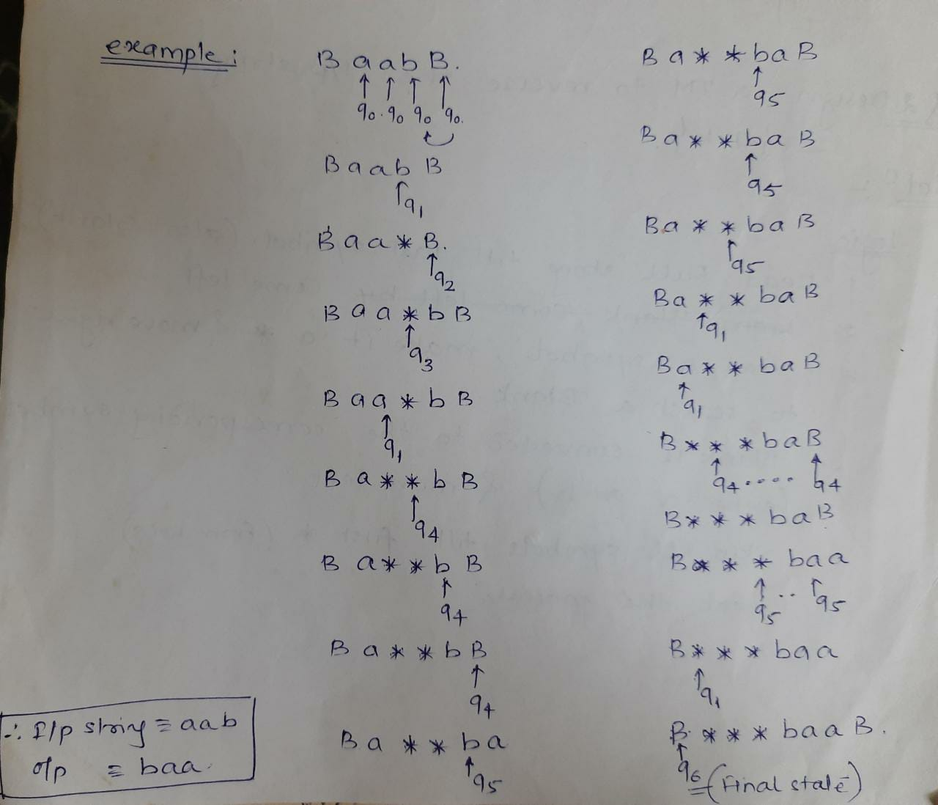

Slide 4
Transition Mapping Function :
a
b
*
B
q0
(q0, a, R)
(q0, b, R)
--------
(q1, B, L)
q1
(q4,*, R)
(q2, *, R)
(q1, *, L)
(q5, B, N)
q2
(q2, a, R)
(q2, b, R)
(q2, *, R)
(q3, b, L)
q3
(q3, a, L)
(q3, b, L)
(q1, *, L)
--------
q4
(q4, a, R)
(q4, b, R)
(q4, *, R)
(q3, a, L)
q5
Final State

Slide 5
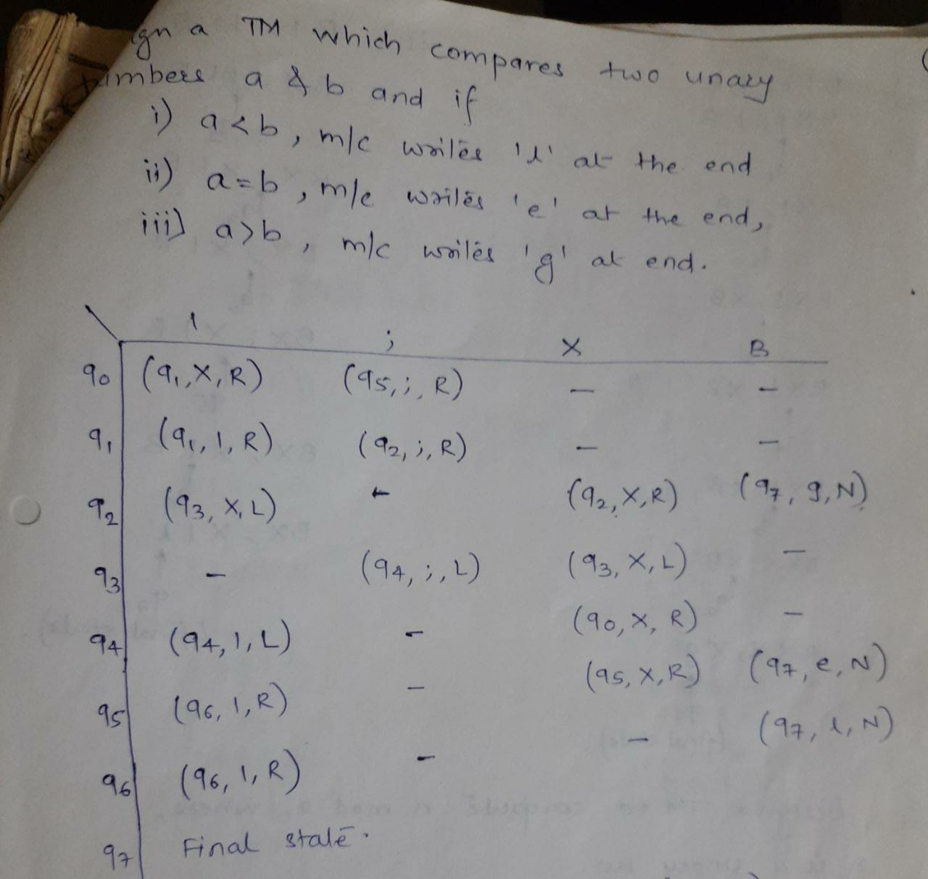

Slide 6
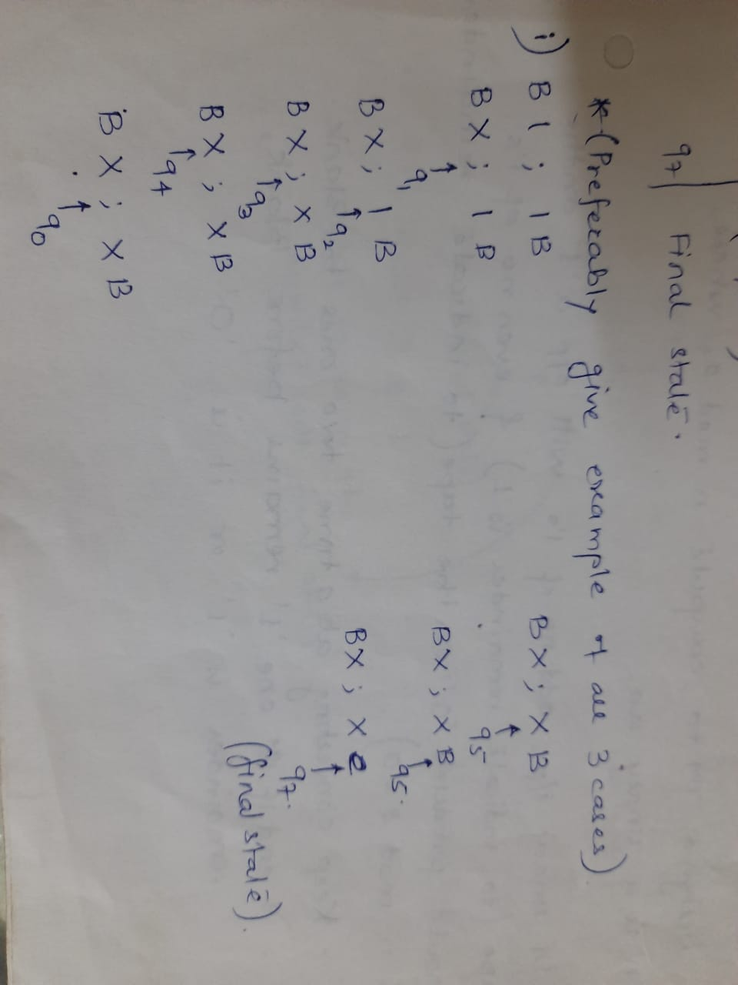

Slide 7
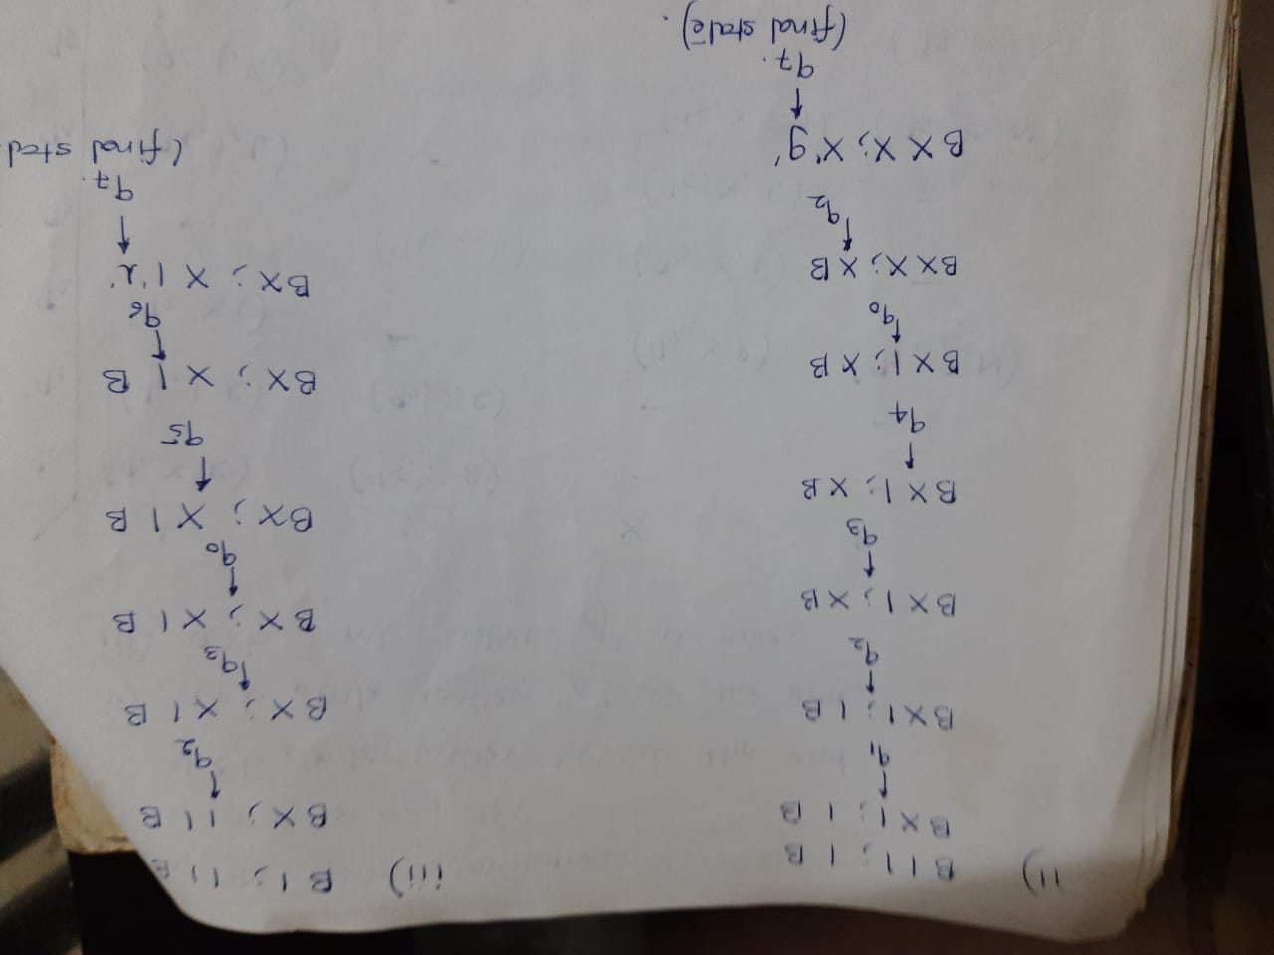

Slide 9
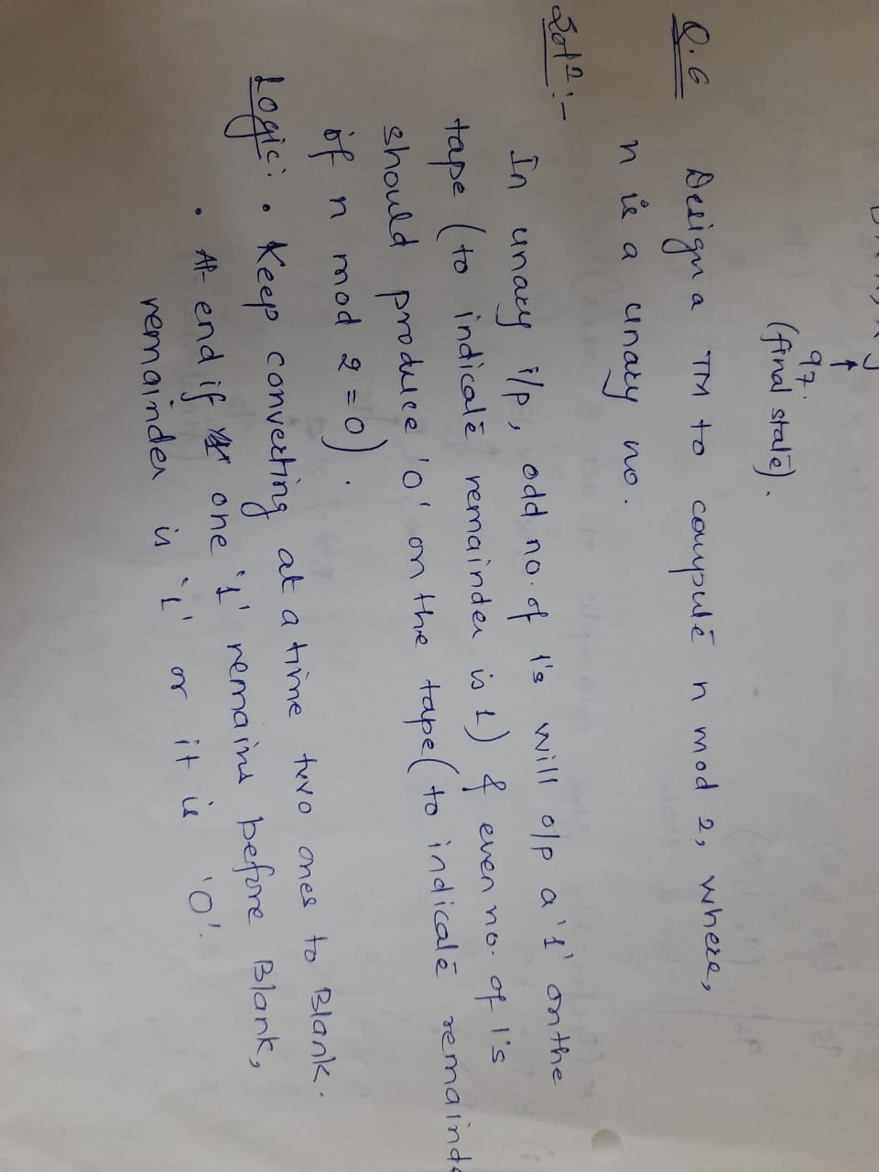

Slide 10
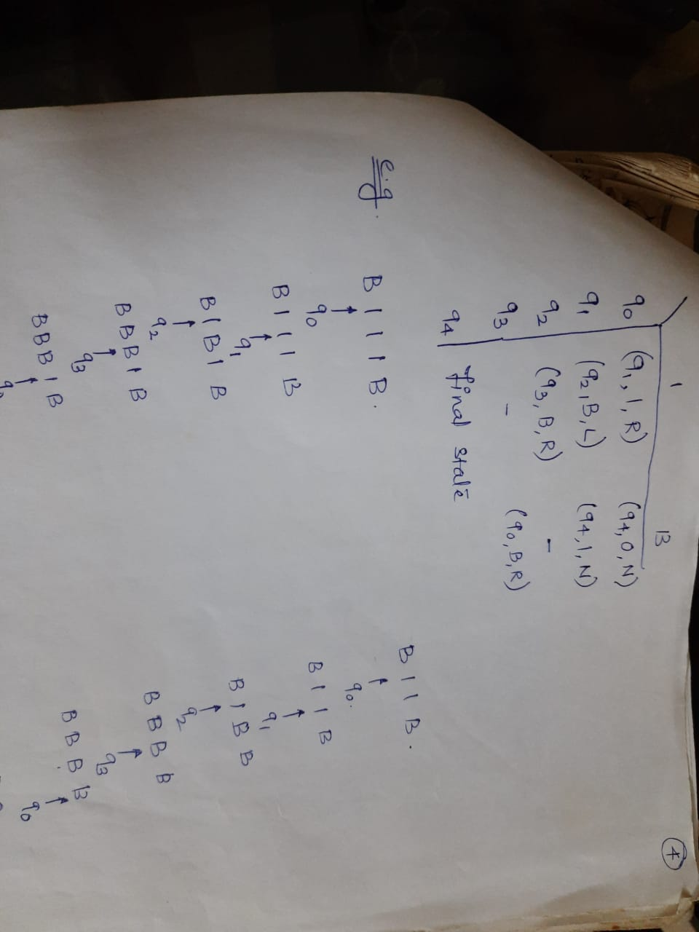

Slide 11
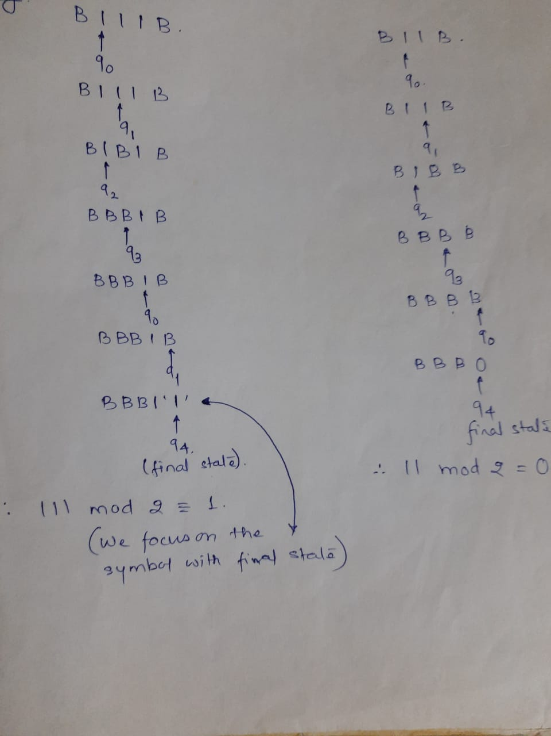

Slide 12
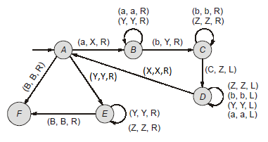
TM with Transition Diagram :

